Slide 1
Advanced Applied Statistics
Predicting Lung Cancer Recurrence
with Multiple Logistic Regression
Marina | Paul | Thomas
New College of Florida
December 2022

Slide 2
Introduction
Goal
Reproduce the results of the paper “Forecasting determinants of recurrence in lung cancer patients exploiting various machine learning models".
Methodology
Multiple Logistic Regression
Bayesian Inference
Preprocessing & Descriptive Analysis
Comparison of Models

Slide 3
Dataset
Source: https://journals.plos.org/plosone/article?id=10.1371/journal.pone.0107276
Dataset consists of information on 174 lung cancer patients patient
Variables describe
Patient statistics (age,sex,smoker)
Cancer status (tumor size/count)
Treatment (duration, methods attempted)
Dataset may have been an entry sheet at some point (.xls sheet, ~1500 (89%) blank rows intersperse data, with filtering applied to ID column
ID values run 1-259, so some entries were likely removed at some point
Header specifies 174 patients, but 194 unique IDs included
Difference likely relates to ‘smoking’ variable (20 blank entries)
May have had multiple data entry methods (multiple date formattings, adjuvent_chemo variable has both binary and categorical entries

Slide 4
Preprocessing
Attempted to duplicate data pre-processing methods in section 2.1:
Filter out entries with NA ‘smoking’ values
Remove ‘status’ variable
Replace NAs with variable mean, when applicable
Encode categorical variables numerically and factorize
Inconsistencies
Descriptions of smoking & status variables did not appear to match dataset
Major changes from original paper
Dropped 20 rows with NA ‘smoking’ values (instead of 24)
Categorical variables defined as factor instead of numerical
Combined categories in adjuvent_chemo variable

Slide 5
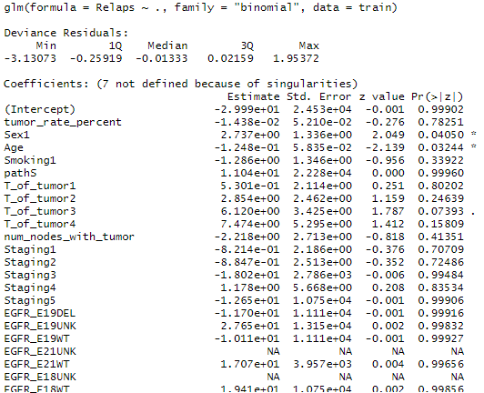
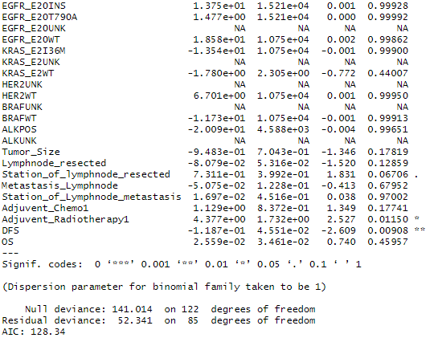
Logistic Regression
Brute Force model with all predictors

Slide 6
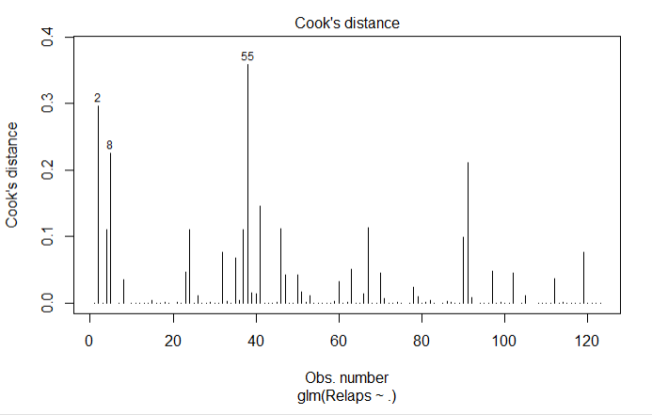
Logistic Regression
Remove outliers via Cook’s Distance
Observations 2, 8 and 55 are removed from the model

Slide 7
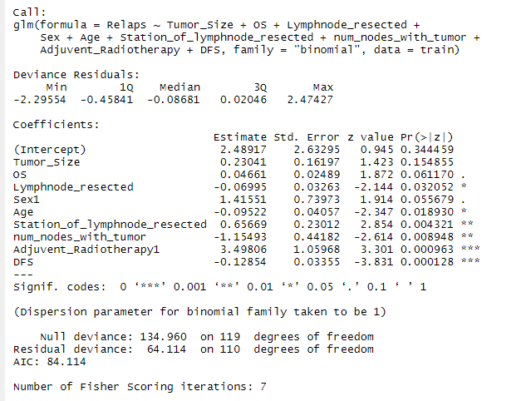
Logistic Regression
Variable Selection via AIC
Response:
Relaps (binary)
Predictors after AIC:
Tumor_Size
OS
Lymphnode_resected
Sex
Age
Station_of_lymphnode_resected num_nodes_with_tumor
Adjuvent_Radiotherapy
DFS

Slide 8
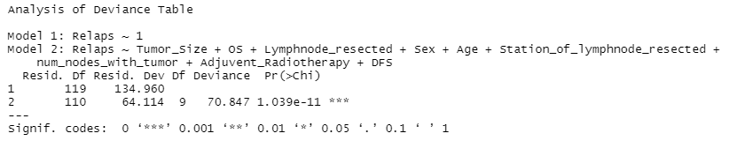
Logistic Regression
Model Significance via Likelihood Ratio Test
Full Model Equation: Relaps~ Tumor_Size + OS + Lymphnode_resected + Sex +
Age + Station_of_lymphnode_resected + DFS
num_nodes_with_tumor + Adjuvent_Radiotherapy
Null Model equation: Relaps~ 1
P-val ≈ 0: Full model is significant. There is an improvement of Full over Null

Slide 9
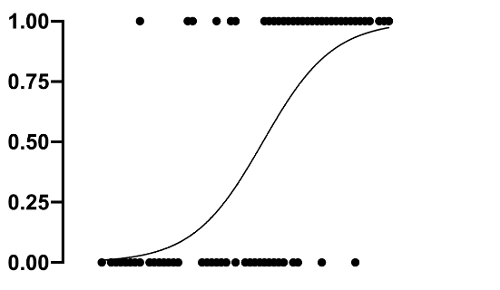

Logistic Regression
Relapse
Threshold: 0.6
—----------------------------------------------
No Relapse
Conceptual representation in 2D. Not realistic since we have multiple predictors
Prediction accuracy on Train Set Prediction accuracy on Test Set
90%
Potential overfit
80%

Slide 10
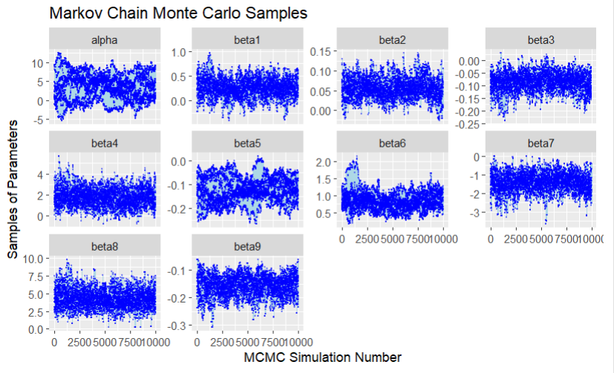
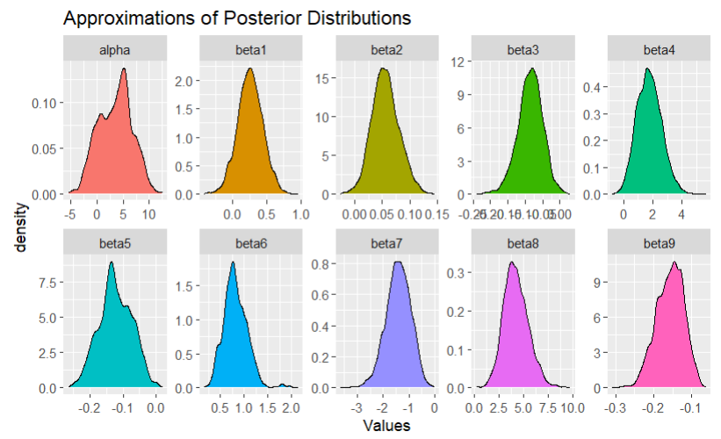
Bayesian Approach
Specify the prior and distribution of response y (which defines likelihood)
MCMC only depends on the prior distribution and the likelihood to generate samples from posterior distribution

Slide 11
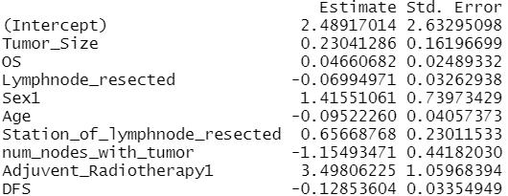
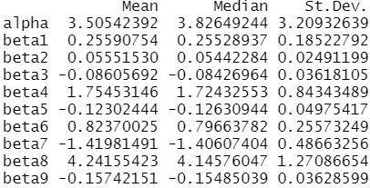
Comparison of Results
Regular Logistic Regression Bayesian Logistic Regression
Train Accuracy: 90% Train Accuracy: 90%
Test Accuracy: 80% Test Accuracy: 80%
While both models have slightly different coefficients and predicted probabilities, when using a probability threshold of 0.6 for making predictions, both models have identical results.

Slide 12
Conclusion
Our logistic regression model achieved test accuracy of ~80%
The paper describes 83% accuracy with their logistic regression model
Difference could be accounted for by interaction terms, which the paper describes as “significantly improving” model performance

